Slide 1
Developing Stored Process Based Web Apps
Using HTML & JavaScript with your Stored Processes to deliver interactive Web Apps to users anywhere.
Phil Mason
Independent SAS Consultant

Slide 2
Stored Processes for beginners
Like a SAS macro
Can pass parameters and define where it will run
Create either in:
Enterprise Guide, auto handle metadata
Define in management console and write code
Run on stored process server or workspace server
Use from various SAS tools, e.g. Web Report Studio

Slide 3
Anatomy of a stored process
Made up of 2 parts:
Metadata
Which server?
Which users?
What parameters?
SAS code, optionally containing
*ProcessBody;
Substitutes parameters for Workspace server
%stpbegin ;
%stpend ;

Slide 4
SAS Code vs. Stored Process
Initiate input parm processing
*ProcessBody;
%stpbegin;
proc print data=sashelp.class ;
run ;
%stpend;
Initiate ODS
proc print data=sashelp.class ;
run ;
Code
Terminate ODS & deliver output

Slide 5
Stored process web application
Part of Integration Technologies
Allows running a stored process
From a web browser
From an application such as EXCEL, MS Word
Parameters passed on URL appear as macro variables to Stored Process

Slide 6
Some techniques for building applications with stored processes
Enterprise guide can generate a web page
Use wizard to do this simply
It prompts for parameters and calls a stored process
(more on next slides)
Stored processes which generate HTML with hyperlinks
Implement drill down, menus, etc.
Stored processes to generate JavaScript
Huge potential for application development

Slide 7
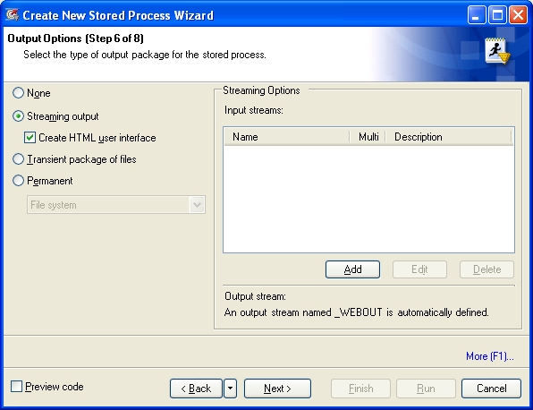
Streaming output & HTML interface

Slide 8
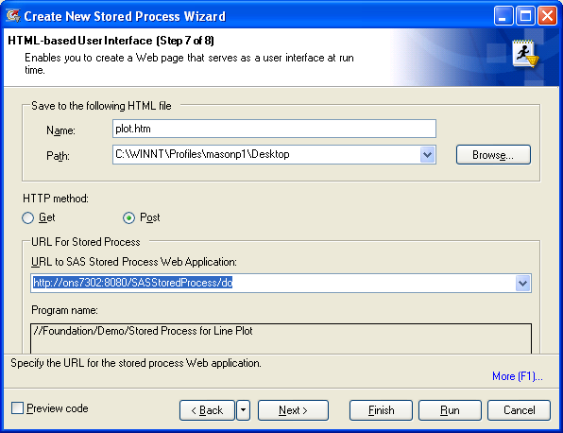
Define HTML file name & SAS Stored Process web application

Slide 9
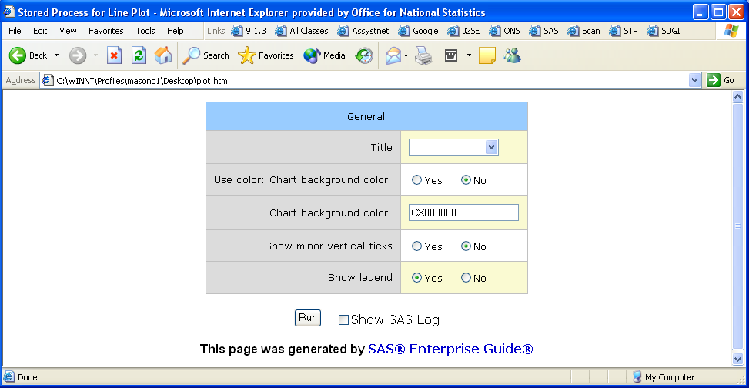
Open web page created

Slide 10
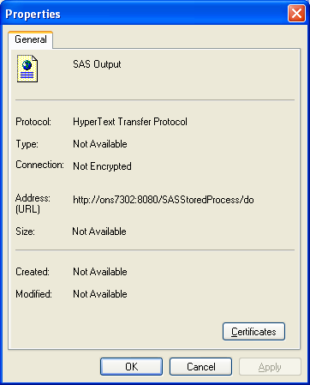
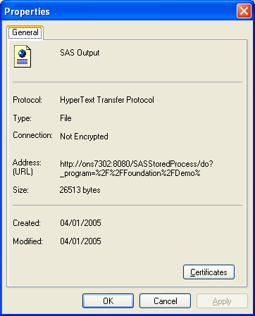
Put vs. Post methods

Slide 11
Get vs. Post method
Get has a limit of about 2,083 characters (on some browsers)
If you pass more they are truncated without warning
Can have unpredictable results
Get
Nice for short URLs
Shows URL to user via properties
Post
More secure, user cant see URL
Needed for long URLs

Slide 12
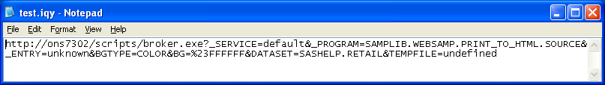
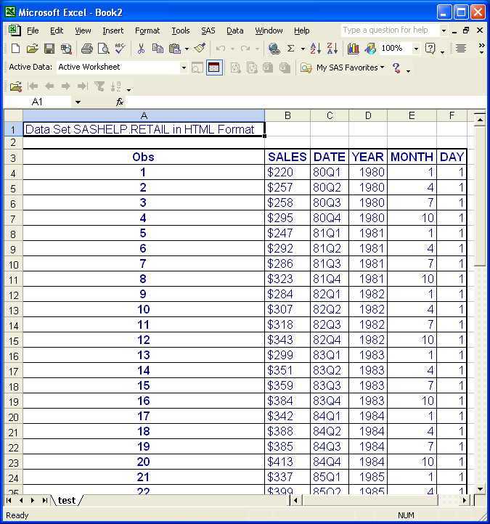
Copy URL to an IQY file

Slide 13
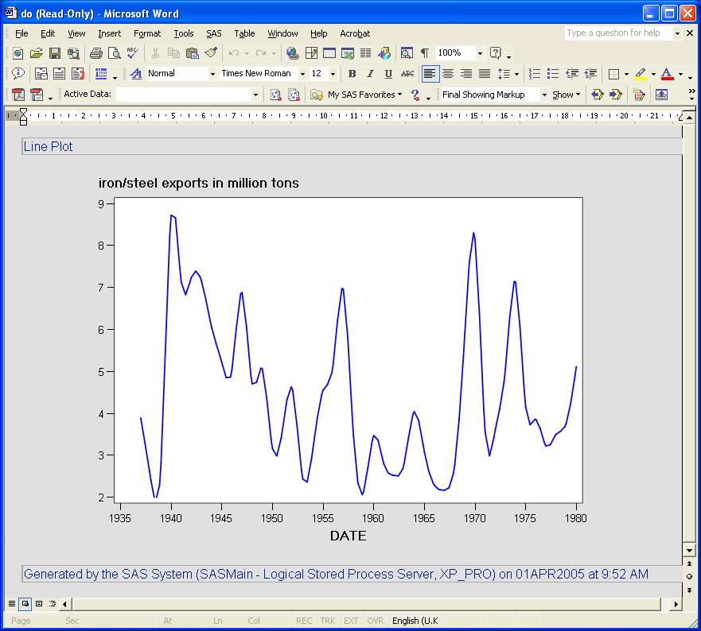
Open URL in Word

Slide 14
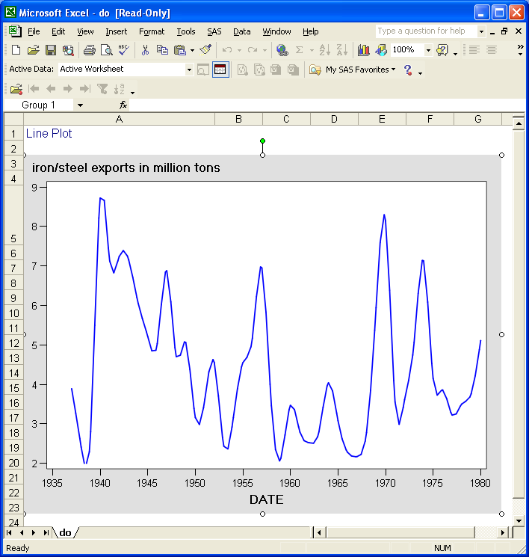
Open URL in EXCEL

Slide 15
Stored Process with menu
Use a single stored process to make a mini application
If specific parameters are passed in then produce report
If they are not, then produce a menu
Menu allows selection of various options
When user clicks on “submit” then stored process is called again
Users selections are passed in

Slide 16
Macro variables used with %stpbegin, which can be specified on a call to Stored Process
_action
Form, execute, properties, background, strip, index, data
_debug
Log, time
My favourite … 2179
_gopt_device
Sasemf, java, activex, png
_gopt_hsize, _gopt_vsize
_gopt_xpixels, _gopt_ypixels
_goptions
_odsdest, _odsoptions, _odsstyle
_program
_result
Status, stream, streamfragment, package_to_email, etc.

Slide 17
Streaming HTML from Stored Process to browser
Set _odsdest=html
or CHTML, PHTML, HTML4, etc.
Set _result to stream
I prefer to set _result to streamfragment
Just writes HTML for reports/graphs without extra bits
No <html> tag or <body> section
Allows more customisation and control

Slide 18
Macro variables that are available from web app
Some of the useful ones, from many
_srvname … server name
_srvport … server port
_url … part of URL
_program … stored process name
_metauser … userid from metadata
_metaperson … name from metadata
_username … userid
Combine to reproduce call to stored process

Slide 19
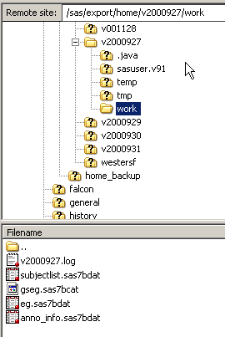
Seeing work datasets from Stored Processes
Usually cant see work datasets of a stored process
Just define a user libref
Libname user ‘C:\temp’ ;
Allows viewing work datasets
Can also redirect log using Proc Printto

Slide 20
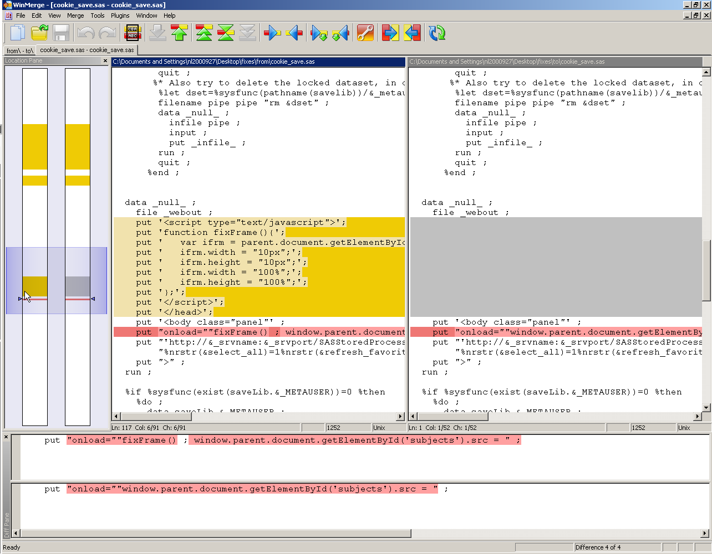
Use WinMerge (or Beyond Compare) to find differences in your code
Free
Open source
Directory/file
Windows
Beyond Compare is better

Slide 21
Writing your own custom HTML
Write to the fileref _webout
Data _null_ ;
File _webout ;
Put ‘<h1>Make your choices and press submit to continue</h1>’ ;
Run ;
Doesn’t work in between %stpbegin & %stpend, since _webout is being used
Usually use with _result=stream, when streaming to browser

Slide 22
A useful addition to this technique
Use Resolve function to resolve any macro variables or macro calls in the datalines.
data _null_;
file _webout;
input ;
line=resolve(_infile_) ;
put line;
cards4 ;
<h1>Welcome to &company_name</h1>
;;;;
Run;

Slide 23
SAS Server Pages
Don Henderson’s idea
Make HTML that has SAS macro calls in it
A macro resolves these calls to produce valid HTML
Read his book for lots of great information
“Building Web Applications with SAS/IntrNet – A guide to the application dispatcher”
This is a good approach, now implemented in SAS 9.3 as Proc Stream

Slide 24
Passing lots of parameters of the same name
Often used in html selection lists
If list is called pick then you will get a collection of macro variables
stored-process-url&pick=a&pick=b
Pick0=2, pick1=a, pick2=b
Its easy to make a macro to construct a macro variable for use with an IN operator
%let picks=“&pick1”,”&pick2” ; … where x in (&picks) ;

Slide 25
Persistence
Passing parameters on URL
Safe & easy, but not always appropriate
Sessions - I don’t recommend
Cookies - I have had mixed results
Files / datasets
Sharing dataset(s)
May need to lock datasets and wait till free

Slide 26
Linking stored processes
Best way I have found is by using the body onLoad method
data _null_ ;
file _webout ;
put '<body class="panel"' ;
Put "onload=""window.parent.document.getElementById(’details').src = " ;
Put "'http://&_srvname:&_srvport/SASStoredProcess/do?_program=SBIP://Foundation/test” ;
Put "%nrstr(&parm1)=120%nrstr(&parm2)=BP' ;""" ;
Put ">" ;
run ;

Slide 27
More useful techniques
Update status as things are running
Produce selection lists of various kinds based on variables in a dataset
Produce messages of various types in HTML code
Write useful JavaScript functions to HTML
Read and write values of HTML cookies
Produce pop-up dialogs

Slide 28
And more … (using JavaScript)
Popup windows
Simple to use the alert function
Taking actions based on user interactions with objects
Using onclick, ondblclick, onmouseover, onkeydown, etc.
Validating form fields
Linking to one or more other URLs
Customising HTML programmatically

Slide 29
JavaScript debuggers
Apart from in IDEs (which are useful for development too)
Some Web browsers have them built in or available as add-ons
Chrome
Firefox, Firebug
Safari, Firebug
Internet Explorer, there are some …

Slide 30
JavaScript frameworks
Provide a set of tools for building interactive web applications
Means you can make great things quickly and easily
Various such as: jQuery, Ext and Dojo.

Slide 31
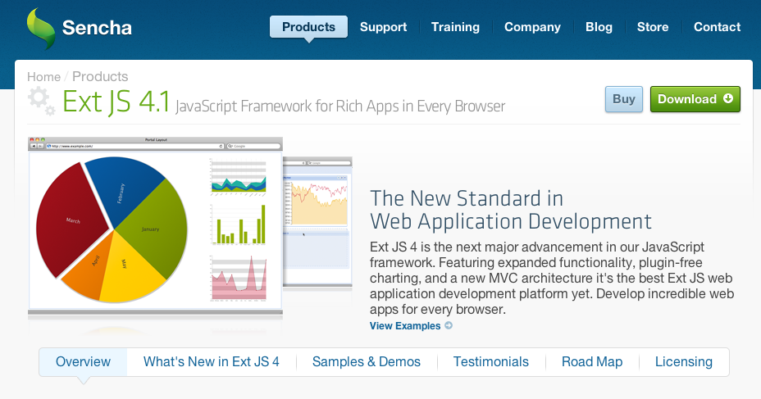
The Ext JavaScript framework home page

Slide 32
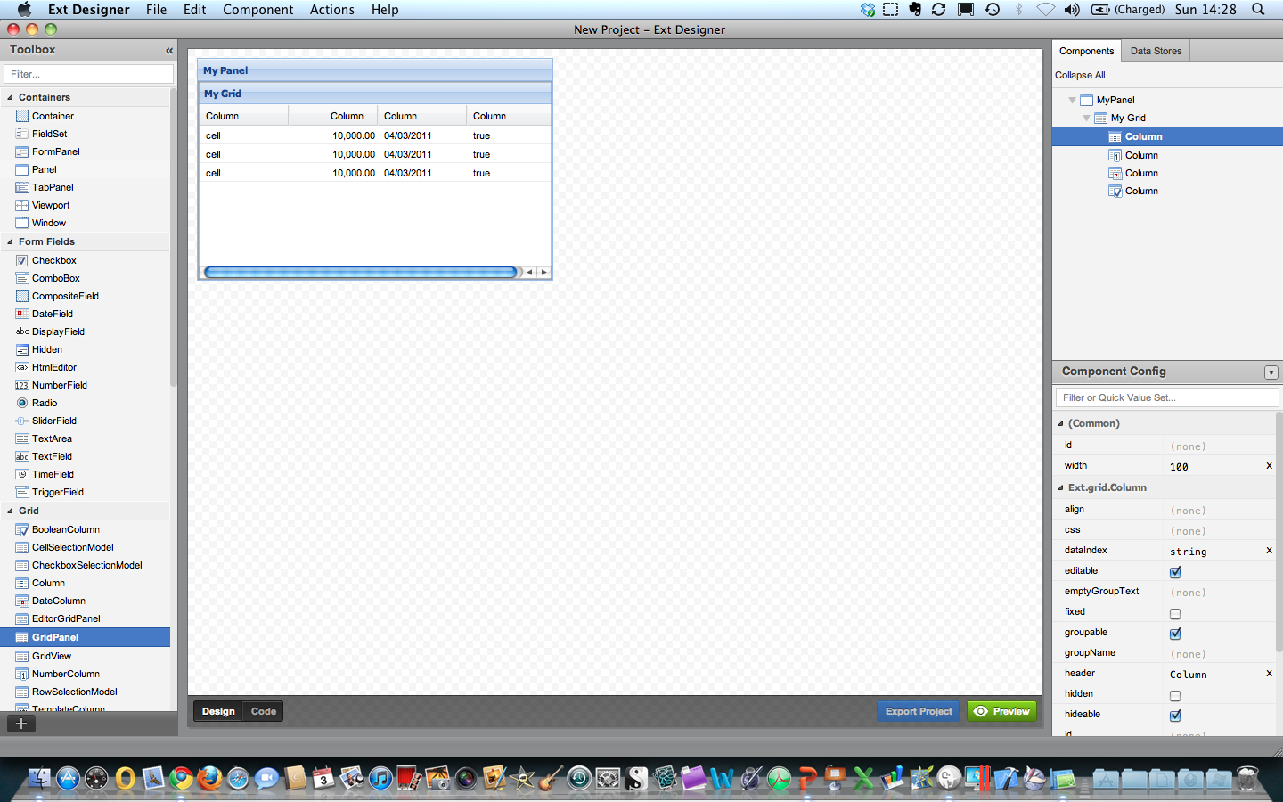
Ext JS Designer

Slide 33
Ext JS & SAS
Ext JS and SAS make a powerful combination
SAS generate dynamic data driven webpages
AJAX (Asynchronous Javascript And XML) requests to SAS Stored Processes
Use Ext JS Graphs and Grids for web reports
SAS produce JSON (JavaScript Object Notation) for objects to use
Requires minimal SAS installation:
SAS Base, Stored Process Server, Metadata Server, Management Console

Slide 34
Data Stores
Data Stores are objects where data is stored for combo boxes, grids, etc.
Local vs. Remote
Local data stores refer to data defined on the client, like a JavaScript Array.
Remote data stores refer to data defined on the server, using AJAX to retrieve the data.
JavaScript objects use data in various formats
Arrays
Simple Stores
XML
JSON

Slide 35
Using SAS to provide data to JavaScript
Key idea
Stored processes can produce any kind of output
Write a stored process to produce required data
e.g. JSON data or XML data
Often a data source can be pointed to from JavaScript
e.g. using the URL parm in Ext JS to point to Stored Process
A Stored Process can write to _webout to write the data to the web browser at the appropriate point
e.g. as an Array or SimpleStore
Notes:
Perhaps describe what a simpleStore is too

Slide 36
SimpleStores & Arrays can be created by SAS
Simplestore – can write from a data step to stream
var values = new Ext.data.SimpleStore({
fields: ['id', 'value'],
data : [['1','A'],['2','B'],['3','C']]
});
Array – can write from a data step to stream
var myCars=new Array(); // regular array (add an optional integer
myCars[0]="Saab"; // argument to control array's size)
myCars[1]="Volvo";
myCars[2]="BMW";

Slide 37
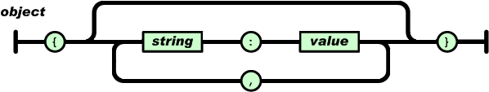
JSON
Key-Value pairs
Man and Machine readable
Nested if necessary
Example:
{ key1 : value1
,key2 : { subkey1: subvalue1 }
}

Slide 38
JSON example (& XML)
The same text expressed as XML:
<menu id="file" value="File">
<popup>
<menuitem value="New" onclick="CreateNewDoc()" />
<menuitem value="Open" onclick="OpenDoc()" />
<menuitem value="Close" onclick="CloseDoc()" />
</popup>
</menu>
{"menu": {
"id": "file",
"value": "File",
"popup": {
"menuitem": [
{"value": "New", "onclick": "CreateNewDoc()"},
{"value": "Open", "onclick": "OpenDoc()"},
{"value": "Close", "onclick": "CloseDoc()"}
]
}
}}

Slide 39
JSON Data Store – best one for Ext JS
Flexible, scalable & more
The store expects JSON data like this:
{ success: true
,rows: [
{id: ‘id1’, val: ‘val1’}
,{id: ‘id2’, val: ‘val2’}
]
}

Slide 40
Using a JSON Data Store produced by a Stored Process
var mydatastore = new Ext.data.Store({
url: "do?_PROGRAM=/CBA/my_data"
,reader: new Ext.data.JsonReader({
root: 'rows',
id: ’name'
}, [’name', ’sex’, ’age’])
} ) ;

Slide 41
AJAX
Communicate with the server asynchronously
No need for complete page refreshes to send or retrieve data
Ext.Ajax.request( {
url : 'do?_program=/myStp/report1' ,
params : { action : 'getDate' },
method: 'GET',
success: function ( result, request ) {
Ext.MessageBox.alert('Success',
'Data return from the server: '+ result.responseText);
},
failure: function ( result, request) {
Ext.MessageBox.alert('Failed', result.responseText);
}
} ) ;

Slide 42
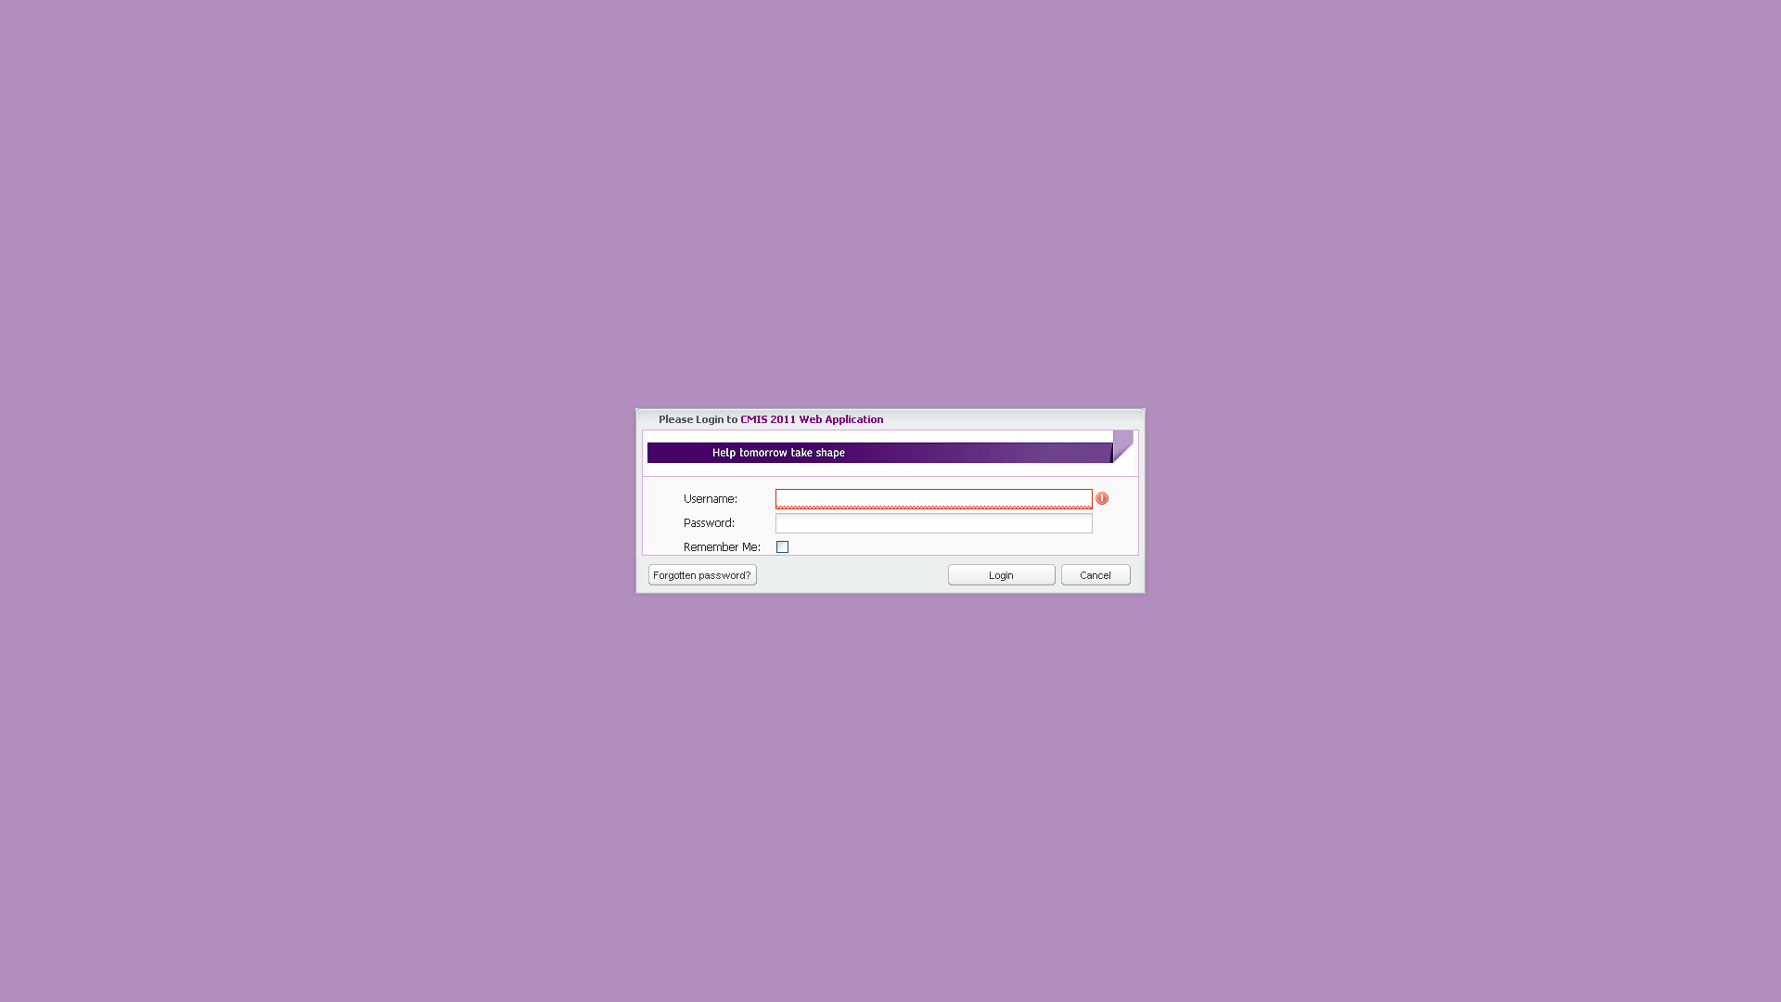
Example of a SAS & Ext JS Web App

Slide 43
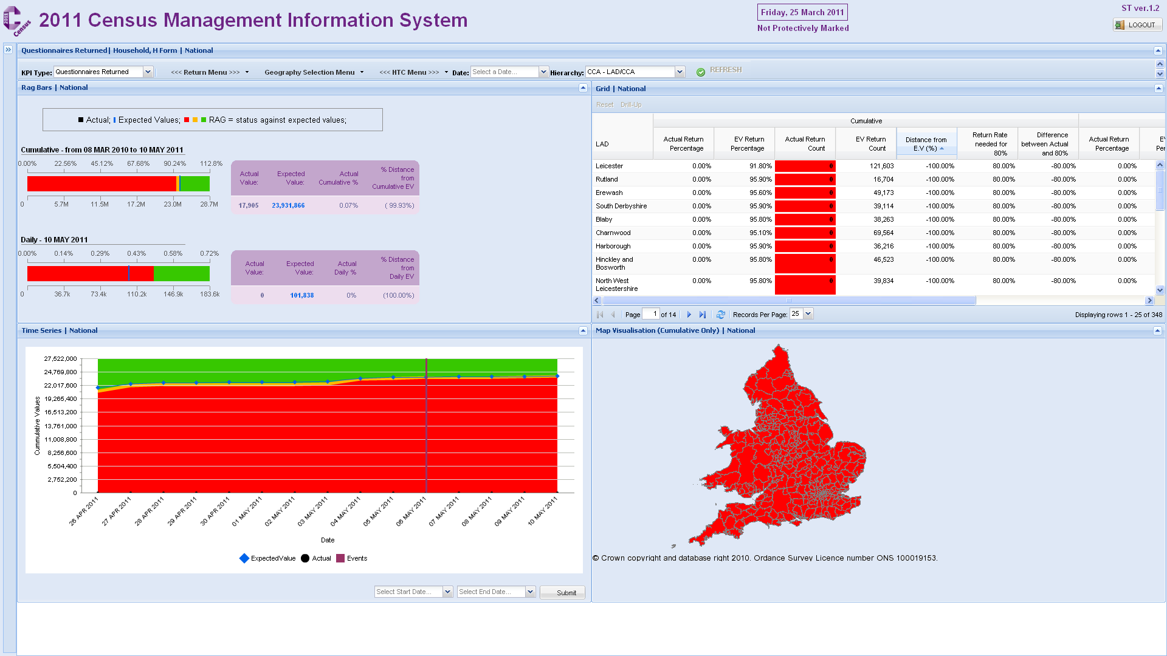
Census Left

Slide 44
Census Right

Slide 45
Conclusions
Stored Processes give you all the power and flexibility of SAS
JavaScript enables interactivity
A JavaScript framework provides a quick start
The techniques in this paper (& my other SAS Global Forum papers) show some ways to put it all together

